Slide 1
WEB & Mobile Application development
Module – 02
JS Class 01
Saylani Mass IT Training Faisalabad
Instructor : Umair Azmat
WhatsApp : +923217061116

Slide 2
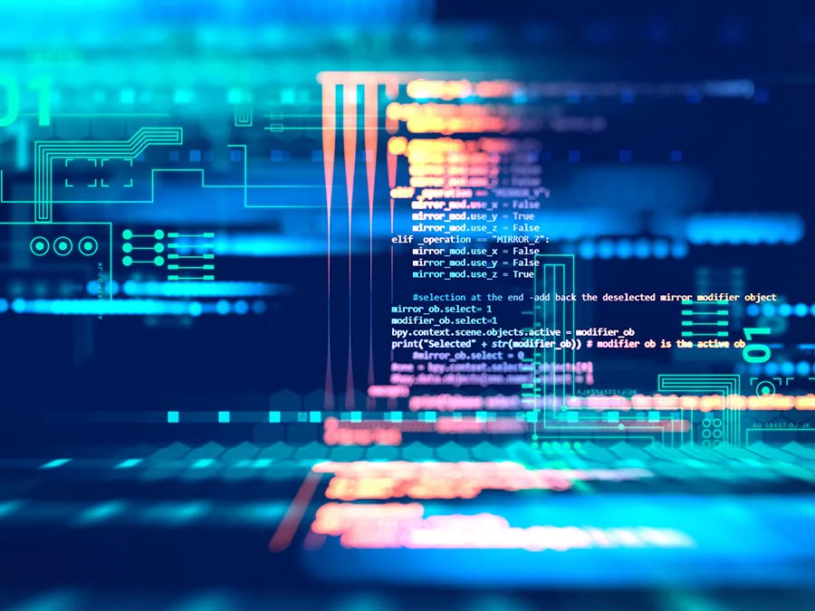
What do you mean by programming?
Programming is the process of creating a set of instructions that tell a computer how to perform a task.
Programming is the process of creating software, applications, and systems using a programming language.
It involves designing, coding, testing, and maintaining software

Slide 3
What are programming Languages?
As we know, to communicate with a person, we need a specific language, similarly to communicate with computers, programmers also need a language is called Programming language.
Language is a mode of communication that is used to share ideas, opinions with each other. For example, if we want to teach someone, we need a language that is understandable by both communicators.
A programming language is a set of instructions, syntax, and rules that are used to communicate with computers and execute specific tasks.
These instructions are written in a specific format that the computer can understand and execute.
Programming languages are used to create software, applications, and systems by providing a way for humans to write code that can be translated into machine-executable instructions.

Slide 4
What is Syntax?
Syntax refers to the set of rules and structure for writing code in a specific programming language, including things like
how statements should be separated:
how variables should be declared?
how functions should be defined?
It also includes specific keywords and symbols used in the language and the proper usage and order of those keywords and symbols.
JavaScript and C++ are both programming languages, but they have some differences in terms of syntax.

Slide 5
What do you mean by Coding?
Coding is a list of step-by-step instructions that get computers to do what you want them to do.
Coding makes it possible for us to create computer software, games, apps and websites.
Coding is the process of writing instructions in a programming language that a computer can understand and execute.
It is a key part of programming and is the process of creating the actual lines of code that make up a software program, application, or system.
Coding involves writing code, debugging, testing, and maintaining the software.
Coders, or programmers, are people who write the program behind everything we see and do on a computer.

Slide 6
1. First-Generation Languages :
First-generation languages are the most basic type of programming languages and are machine-dependent.
They are directly executed by the computer's central processing unit (CPU) and are written in binary code, which consists of only 0s and 1s.
Because of their binary code, they are not easily readable by humans and are difficult to write and debug.
These languages are used to write system-level software, device drivers, and operating systems.
Examples include binary code and machine code.
In the beginning, at the birth of computing, there were no programming languages. Programs looked something like this:
00110001 00000000 00000000
It's important to note that while first-generation languages are the foundation of all other programming languages, they are not widely used today as they are not user-friendly.

Slide 7
2. Second-Generation Languages:
2G languages, also known as assembly languages, were developed to provide a higher level of abstraction than first-generation languages.
They are machine-dependent and are not as high-level as modern languages.
They are a symbolic representation of machine code and use mnemonics, or abbreviations, to represent the machine code instructions.
This makes them more human-readable than machine code or binary code, but they are still difficult to write and debug.
Examples of 2G languages include assembly languages such as x86 assembly, ARM assembly, and MIPS assembly, object code languages such as object file and object module, and macro assemblers.
2G languages are rarely used today as they are not user-friendly and have been replaced by high-level languages that provide a higher level of abstraction and are more human-readable.

Slide 8
3. Third-Generation Languages:
3G languages, also known as high-level languages, were developed to provide an even higher level of abstraction than second-generation languages.
They are machine-independent and are more user-friendly than previous generations of languages.
They use English-like keywords and commands, which makes them easier to read, write, and understand for humans.
They are more portable across different types of computers, as they are not tied to a specific machine's architecture.
Examples of 3G languages include C, C++, COBOL, Fortran, Algol, and PL/I.
3G languages are still in use today and are popular for system programming, scientific computing and other specialized purposes.

Slide 9
4. Fourth-Generation Languages:
4G languages, also known as very high-level languages, were developed to provide an even higher level of abstraction and ease of use than third-generation languages.
They are used to create software applications that can be used by non-programmers.
They are often used for database access and manipulation, as well as for creating user interfaces.
They are designed to be easy to use and require little or no programming knowledge.
They are also designed to be platform-independent and can run on multiple operating systems and hardware architectures.
Examples of 4G languages include SQL, Python, JavaScript, and others.

Slide 10
5. Fifth-Generation Languages:
5G languages, also known as expert system languages, were developed to provide a high level of abstraction and ease of use for artificial intelligence and expert system applications.
They are designed to be used by non-programmers and provide a high level of automation.
They are ideal for tasks such as natural language processing, knowledge representation, and reasoning.
They are also designed to be platform-independent and can run on multiple operating systems and hardware architectures.
Examples of 5G languages include Prolog, LISP e.t.c
5G languages are still in use today, but they are not as popular as they once were due to the development of more advanced AI techniques and languages.

Slide 11
Assembler, Compiler & Interpreter
An assembler is a type of software that converts assembly language, which is a low-level programming language, into machine code, which is the binary code that is executed by a computer's central processing unit (CPU). Assembly language instructions are typically mnemonics that are easier for humans to read and write, but they still correspond directly to the machine code instructions that are executed by the CPU.
A compiler is a type of software that converts a high-level programming language, such as C or Java, into machine code. The process of compiling a program is typically done before the program is executed, and the resulting machine code can be executed on the target platform without the need for a compiler to be present at runtime. Compilers can also perform other tasks, such as optimizing the code for better performance or detecting errors in the source code.
An interpreter is a type of software that reads and executes source code written in a high-level programming language, such as Python or JavaScript, line by line at runtime. Unlike a compiler, an interpreter does not generate machine code, but instead, it directly executes the instructions in the source code. Interpreters are typically used in languages that are designed to be more human-readable and interactive, such as scripting languages.

Slide 12
Why programming is Important? (1)
Programming language helps humans accurately communicate with machines.
Automation: Programming allows us to create software that can automate repetitive tasks, which can save time and increase efficiency.
Problem-solving: Programming enables us to write code that can solve problems and make decisions, which can be used in a wide range of applications such as finance, healthcare, and transportation.
Innovation: Programming allows us to create new technologies and applications that were once impossible, leading to innovation and progress in different areas.
Job creation: Programming is a valuable skill in today's job market, and the demand for programmers is high. It creates new jobs and industries.

Slide 13
Why programming is Important? (2)
Interaction with technology: It allows people to interact with technology by creating software that can be used by people with different abilities, and make technology more accessible.
Entrepreneurship: Programming allows individuals to build their own software products, and start their own companies or develop their own ideas.
Learning: Programming is a valuable tool for learning, as it helps to develop logical thinking, problem-solving skills, and perseverance.
Creativity: Programming allows for creativity in designing and building new software, applications, and systems.

Slide 14
Programming
Coding
In Programming, we think How to Solve a Problem?
Programming is the process of designing, creating, testing, and maintaining software using programming languages.
Programmers use a variety of tools and techniques to design and develop software, such as flowcharts, pseudocode, and debugging tools.
In Coding we write the solution of problem in system.
Coding is the process of writing instructions in a programming language that a computer can understand and execute.
Coders use a specific programming language to write the code, such as Python, Java, or C++.

Slide 15
Programming
Coding
Programming requires an understanding of computer science concepts such as algorithms, data structures, and software design principles.
Example: A student designs a program that can grade multiple-choice tests.
Coding requires a knowledge of a specific programming language's syntax and rules.
Example: A student writes the code in Python that can read the answers from a file and compare them to the correct answers.
Programming is the overall process of designing, creating, testing, and maintaining software, while coding is the specific act of writing instructions in a programming language that a computer can understand and execute.
Both are important to the process of creating software, but they have different aspects. Programming requires an understanding of computer science concepts and design principles, while coding requires knowledge of a specific programming language's syntax and rules.

Slide 16
JavaScript
JavaScript is an interpreted, client-side, event-based, object-oriented, scripted language.
It was introduced in 1995 for Netscape Navigator and has since been adopted by all major web browsers.
Interpreted: Code is executed line by line at runtime, rather than being compiled beforehand.
Client-side: The code is executed on the user's browser, rather than on the server. Just tell what to do! Not how to Do!
Event-based: Responds to user events such as clicks and hovers.
Object-oriented: Follows an object-oriented programming paradigm and allows for the creation of objects with properties and methods.
Scripted: The code is written in scripts and executed in a sequential manner.
JavaScript is Case-Sensitive.

Slide 17
JavaScript
JavaScript is a high-level programming language used for web development.
"Java is to JavaScript what car is to carpet.“
It is the most popular and widely used programming languages in right now
Facebook - The main frontend of the website is built using JavaScript, React and Redux.
Netflix - The frontend for the video streaming platform is built with JavaScript.
Walmart - The retail giant uses JavaScript for both frontend and backend web development.
Airbnb - The popular home-sharing platform has a large JavaScript codebase, using React on the frontend.
PayPal - The online payment system uses JavaScript for both frontend and backend development.
Uber - The transportation network company uses JavaScript extensively for building its web and mobile application

Slide 18
What JavaScript can do?
Dynamic Web Interactivity: Enables user interaction with web pages without reloading the page, making it a key component of modern web applications.
Validation and Data Manipulation: Provides client-side form validation, data processing, and manipulation, reducing the load on servers.
Development of Browser Extensions: Allows developers to create browser extensions to extend the functionality of browsers.
Server-side Processing: Can also be used on the server-side through technologies such as Node.js, providing the capability to build full-stack applications.
Creating Games: JavaScript is capable of creating simple to complex games that can run in the browser.
Animation and Effects: Allows for the creation of animations, special effects, and visual transitions in web pages.

Slide 19
JavaScript Libraries vs. Frameworks:
JavaScript Libraries | JavaScript Frameworks
jQuery | Angular
Lodash | React
Moment.js | Vue.js
Swiper.js | Ember.js
Chart.js | Backbone.js

Slide 20
Camel case | Pascal case
Definition | First word in lowercase, subsequent words capitalized | Every word capitalized
Example | firstName, lastName | FirstName, LastName
Common use in programming | Variable and function names | Class, enum, and constant names
Example programming language | JavaScript, Java, C# | C++, C#, Java

Slide 21
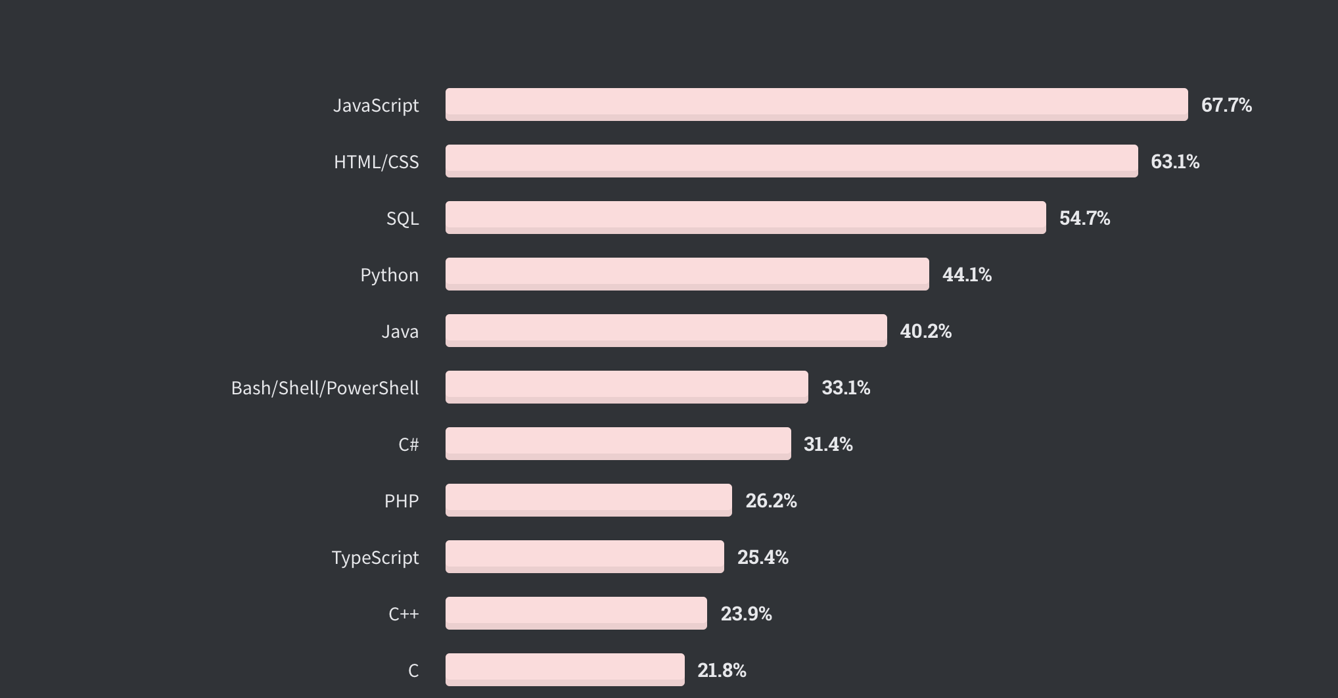
JavaScript Popularity
According to the 2022 Stack Overflow Developer Survey , JavaScript is the most popular coding language.

